Slide 1

Database Systems Dr Muhammad Ayub Ansari Lecture 7: PHP Part 2 – Functions, Classes , DB Connections

Slide 2
Strings (Concatenation)
A string can be used directly in a function or it can be stored in a variable.
The concatenation operator ‘.’ is used to put two string values together.
$var1="Hello";
$var2="World";
echo $var1 . " " . $var2;
Concatenation

Slide 3
Strings (strlen())
The strlen() function is used to find the length of a string.
The length of our string "Hello world!" can be determined thus:
echo strlen("Hello world!");
The output from the above will be: 12 (Test a few strings to find out)
String Length

Slide 4
Strings
The length of a string is often used in loops or other functions, when it is important to know when the string ends.
We can stop the loop after the last character in the string
for($i = 0; $i < strlen($var1); $i++)

Slide 5
Arithmetic Functions
There is a collection of arithmetic functions built in to PHP
Many are typical of functions / methods available in most languages
Some have been created by PHP developers and are not available in other languages.
Notes:
Ask for examples.

Slide 6
round()
Math Functions
pow()
rand()
max()
min()
pi()
sqrt()

Slide 7
User Defined Functions

Slide 8
Functions
Functions exist in most programming languages
Java:
public void myMethod()
public String myMethod(String aString) {return aString;}
A specific piece of code that performs a single well defined task
Reuse the code whenever the task needs to be performed
Most of the PHP web programming language is function based

Slide 9
Functions
All function definitions start with the word "function"
Name the function
It should be possible to understand what the function does by its name.
The name can start with a letter or underscore (not a number)
A function is called by its function name
myfunction();

Slide 10
Functions
Function names are not case sensitive
myfunction();
MYFUNCTION();
MyFunction();
It is important to note that function names behave differently to variable names, which are case sensitive.
$Func; $func are two separate variables
Func(); func() are the same function

Slide 11
Functions
A function may be defined using syntax such as the following:
function myfirst ($arg_1, $arg_2, ..., $arg_n)
{
echo "Example function.\n";
return $retval;
}

Slide 12

A function to tabulate a list of comma-separated values
<?php
function tabulate($s)
{
echo "<table border='1'><tr>";
$words = explode(',', $s); //Split the string into an array using the comma as a delimiter
foreach ($words as $word)
{
echo "<td>$word</td>";
}
echo "</tr></table>";
}
// Call the function with sample inputs
tabulate("this,is,the,cat");
tabulate("that,caught,the,rat");
?>

Slide 13
Functions
NOTE: the rules on scoping are unusual.
The term scope refers to places within a script where a particular variable is visible.
Variables used inside functions are local to the function.
Variables declared outside functions are in scope from the statement in which they are declared to the end of the file in which they are used
Variables declared outside functions are not global to a function.

Slide 14
Functions
Variables declared inside a function are in scope until the end of the function.
<?php
function create($data)
{
echo "<table>;
reset($data);
$value = current($data);
while ($value)
{
echo "<tr><td>".$value."</td></tr>";
$value = next($data);
}
echo "</table>";
}
$my_array = array('Line one.','Line two.','Line three.');
create($my_array);
?>

Slide 15
Functions
Global variables are not know inside functions
<?php //calculateprice.php
// Define a tax rate:
echo $tax = 10.00;
// This function performs the calculations.
function calculateprice($quantity, $price)
{
$total = $quantity * $price; // Calculation
$taxrate = ($tax / 100) + 1;
echo "tax = " . $tax . "<br>";
$totaltax = $total * $taxrate; // Add the tax.
$totalprice = number_format ($totaltax, 2); // Formatting
return $totalprice; // Return the value.
} // End of function.
echo calculateprice(100, 10)
echo $tax = 11.00;
?>

Slide 16
Functions
Variables created within a function can be made global by using the keyword global.
<?php
function calculateprice($quantity, $price)
{
global $tax;
……
……
}
?>

Slide 17
Functions
<?php //globalcalculateprice.php
// Define a tax rate:
echo $tax = 10.00;
// This function performs the calculations.
function calculateprice($quantity, $price)
{
global $tax;
$total = $quantity * $price; // Calculation
$taxrate = ($tax / 100) + 1;
echo "tax = " . $tax . "<br>";
$total = $total * $taxrate; // Add the tax.
$total = number_format ($total, 2); // Formatting
return $total; // Return the value.
} // End of function.
echo calculateprice(100, 10)
?>

Slide 18
Functions
<?php //calculate.php
include(globalcalculateprice.php);
$tax = 20.00;
echo $tax;
echo calculateprice(100, 10);
?>

Slide 19
Pass by Value
<?php
function increment($value, $amount = 1)
{
$value = $value + $amount;
}
$value = 8.75;
increment($value);
echo $value;
?>

Slide 20
Pass by Reference
<?php
function increment(&$value, $amount = 1)
{
$value = $value + $amount;
}
$refvalue = 8.75;
increment($refvalue);
echo $refvalue;
?>

Slide 21
Objects

Slide 22
Object Orientated PHP
Creating an object in PHP is not much different to creating an object in any other programming language.
Solves the issue of function orientated / procedural programming in web scripts.
We can now implement OO principles that are not available in other web scripting languages.

Slide 23
Object Orientated PHP
<?php //ow-do.php
class HelloWorld
{
function say_hello ($language = ‘Yorkshire')
{
switch ($language)
{
case 'French':
echo 'Bonjour, monde!';
break;
case 'German':
echo 'Hallo, Welt!';
break;
default:
echo ‘ow-do, world!';
break;
} // End of switch.
} // End of say_hello() function.
} // End of HelloWorld class.
?>
<?php //testhelloworld.php
include(“ow-do.php");
$hello = new HelloWorld();
$hello->say_hello();
?>

Slide 24
Object Orientated PHP
<?php //testhelloworld2.php
// Include the class definition:
Require_once (“ow-do.php”);
// Create the object:
$obj = new HelloWorld();
// Say hello in different languages:
$obj->say_hello(‘German');
$obj->say_hello('Dutch');
$obj->say_hello('French');
// Delete the object:
unset($obj);
?>

Slide 25
Object Orientated PHP
require() will produce a fatal compile error and will halt the script.
include() only emits a warning which allows the script to continue.
The require_once() statement will check if the file has already been included, and if so, not include it again.
$obj->say_hello(); The pointer is similar to the dot notation in Java
unset($obj); If we do not need a variable again we can clean it up to save resources
http://php.net/manual/en/function.unset.php

Slide 26
Object Orientated PHP
<?php //constructordemo.php
// Define the class:
class Demo
{
public $i = 5;
function __construct(){echo "Construct $this->i";} // Constructor:
} // End of Demo class.
// Create the object:
$o = new Demo();
echo "<p>";
echo "Print i = " . $o->i;
echo "<p>";
// Delete the object:
unset($o->i);
unset($o);
echo "print again =" . $o->i;
?>

Slide 27
Object Orientated PHP
<?php
class User
{
private $user = "";
private $valid;
function _Consrtuct() { $this->valid = False; }
function setValid($valid){ $this->valid = $valid; }
function getValid() { return $this->valid; }
function setUser($user) { $this->user = $user; }
function getUser() { return $this->user; }
}
?>

Slide 28
Object Orientated PHP
<?php
class Calculator
{
$value;
function setValue( $value )
{
$this->value = $value;
}
function getValue()
{
return $this->value;
}
}

Slide 29
MySQL Connections

Slide 30
Types of Connections
MySQL
MySQLi
PDO (PHP Data Object)

Slide 31
MySQL
Unsafe
SQL injections
Obsolete.

Slide 32
MySQLi
Safe and Secure
Faster
Better set of Functions and extension.
Supports MYSQL from version 4.1.13 to latest.

Slide 33
PDO – PHP Data Objects
Database abstraction layer
Acts as interface between MySQL and backend
Works with multiple databases
Keeps source code simple and portable.

Slide 34
MySQLi - Functions
Mysqli_connect() or invoke MySQli constructor
Establishes a connection to MySQL database.
Function arguments required,
Host = “localhost”
Username = “u2100011”
Password = “your_password”
Database = “Db_Name”

Slide 35
MySQLi - Prepare
Prepare an SQL statement for execution
Returns FALSE if there is an error
Connection -> prepare(query)

Slide 36
MySQLi – Bind_param()
binds variables to a prepared statement as parameters
The concept of the prepared statement is to send a template of the query to be executed and then send the data separately
Prevents hackers from interfering with the query
Bind_param (sssd, represents characters which specify the types for the corresponding bound variables)
i = type integer
s = type string
d = type double
b = type blob

Slide 37
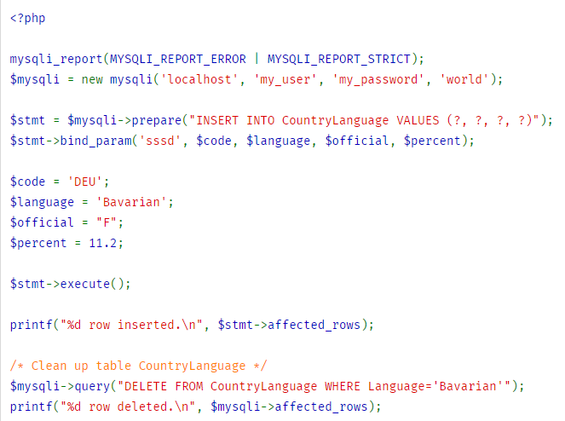

Slide 38
MySQLi – execute()
Executes a query that has been previously prepared using the prepare( ) function.
When executed, any parameter markers which exist will automatically be replaced with the appropriate data.
Returns TRUE on success or FALSE on failure.

Slide 39
MySQLi – mysqli_fetch_array()
A function for dealing with result table, to access the returned data.
Returns an array of strings that corresponds to the fetched row, or FALSE if there are no more rows.
The type of returned array depends on how result_type is defined.
By using MYSQL_BOTH (default), you'll get an array with both associative and number indices.
Using MYSQL_ASSOC , you only get associative indices
Using MYSQL_NUM, you only get number indices

Slide 40
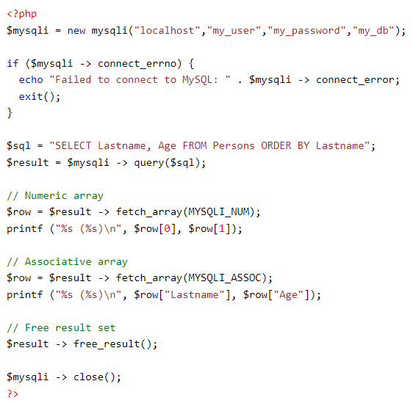

Slide 41
MySQLi – mysqli_num_rows()
Returns the number of rows returned from a select statement.
This command is only valid for statements like SELECT or SHOW that return an actual result set.
Retrieves the number of rows from a result set or FALSE on failure.
$query= "select £name, lname, email from ea_Client";
$resultid = mysqli_query($linkid, $query) or die(mysql_error($linkid));
echo "Congratulations, your query has returned "; echo mysqli_num_rows($resultid);
echo " rows of data";

Slide 42
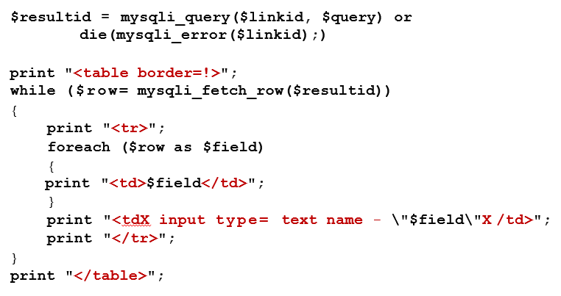
MySQLi – mysqli_fetch_row()
Retrieve one row of data from the result associated with the specific results identifier.
The row is returned as an array.

Slide 43
Demo time
Select data and delete data from Table

